Slide 1
slide loop GDB logo intro by participants

Slide 2

WELCOME IN YOUR LOCATION

Slide 3
slide opening GDB 2018 (45 miniutes)
Leader_ Intro Marcel / Mathias / Rene _Thank you local venues / sponsors
Keynote Buck Hodges _Outro Buck Hodges _Hand over to Marcel (animation + music) Marcel handover to local venue _Lead out

Slide 4
FROM ONCE A MONTH TO MULTIPLE TIMES A DAY
Applied modern release patterns and practices

Slide 5
WHY? DRIVING FORCES
DIGITAL TRANSFORMATION, DIGITAL DISRUPTION, TIME TO MARKET PRESSURE, COST PRESSURE
CLOUD ENABLES NEW BUSINESS MODELS, FAST INNOVATION, LOW BARRIER TO ENTRY IN A NEW MARKET AND CAN BE A COST SAVER
CAPEX - OPEX CHANGE IS DISRUPTIVE FOR THE INDUSTRY;
E.G. MICROSOFT VSTS OFFERS 24X7 SERVICES WITH MARGINAL COSTS PER USER COMPARED TO CAPEX INVESTMENT IN TFS IN THE PAST. ADDITIONAL BONUS FOR CUSTOMER: NO MAINTENANCE AT ALL!

Slide 6
MOVING FROM RESOURCE OPTIMIZED TO TIME TO MARKET OPTIMIZED BUSINESS MODELS

Slide 7
99% OF ORGANIZATIONS ARE OPTIMIZED ON RESOURCES, BETTER KNOWN AS PEOPLE
EVERYONE WITH THE SAME TYPE OF WORK (LOGICAL COHESIVE) WORKS TOGETHER ON SIMILAR WORK
PEOPLE ARE EXCHANGEABLE, PROCESS DRIVES THE DELIVERY AND IS DESCRIBED IN DETAIL TO CREATE A PREDICTABLE OUTCOME;
WORK BECOMES MUNDANE, NO EMPOWERMENT, HIERARCHICAL ORGANIZATIONS;
DEPARTMENTS ARE SILOS;
TICKETS TO TRANSFER WORK TO OTHERS.
NOW MOVE TO FUNCTIONAL COHESIVE
CUSTOMER JOURNEY;
FEWER PEOPLE HANDLES THE VALUE STREAM.

Slide 8
HOW WOULD A JOURNEY TOWARDS MULTIPLE RELEASES IN A DEVOPS TEAM
LOOK LIKE?

Slide 9

INTRODUCING
GDBC INC.
MUSIC STORE COMPANY / SELLS VINYL RECORDS / HAS ONLINE SHOP / NEEDS TO COMPETE NOW

Slide 10
ISSUES GDBC INC.
NEW INVESTMENT NEEDED IN DATACENTER
HARD TO MAKE CHANGES TO CURRENT APPLICATION
ALL CHANGES IN A RELEASE REQUIRE DOWNTIME
HARD TO COMPETE IN CURRENT BUSINESS, NEED TO CHANGE THE MODEL
SELL OTHER PRODUCTS, SUBSCRIPTION SERVICES, ETC?
CUSTOMER FEEDBACK HAS BEEN THAT THE ONLINE SHOP WAS TO SLOW AND OLD FASHIONED
NEED FOR REVAMP OF THEIR ONLINE PLATFORM

Slide 11
STRATEGY GDBC INC.
MOVE FROM THE TRADITIONAL ENTERPRISE APPROACH TO THE DEVOPS APPROACH
GET A CUSTOMER CENTRIC APPROACH TO DELIVER SOFTWARE
TIME TO MARKET IS HIGHEST PRIORITY
GIVES FLEXIBILITY AND POWER TO SATISFY CUSTOMERS FAST
MOVE FROM TRADITIONAL DATA CENTER TO CLOUD
USE CLOUD AS ACCELERATOR TO TRANSFORM FASTER
CHANGE REQUIRES RIGHT COMBINATION OF PEOPLE, PROCESS AND TOOLS TO BE IN ALIGNMENT TO MAKE THIS SUCCESSFUL

Slide 12
“IF THERE WAS NOTHING PREVENTING A SYSTEM FROM ACHIEVING HIGHER THROUGHPUT, ITS THROUGHPUT
WOULD BE INFINITE. ONLY BY INCREASING FLOW THROUGH THE CONSTRAINT CAN OVERALL THROUGHPUT BE INCREASED.”
Elyahu M. Golratt _ The Goal

Slide 13
HOW TO OPTIMIZE
GDBC INC.
VALUE DELIVERY
PIPE LINE WITH BOTTLENECK
REMOVE BIGGEST BOTTLENECK / MORE FLOW
WHAT IS NEXT / NEXT BIGGEST BOTTLENECK

Slide 14

1
BOTTLENECK
ORGANISATION AND LACK OF FLOW

Slide 15




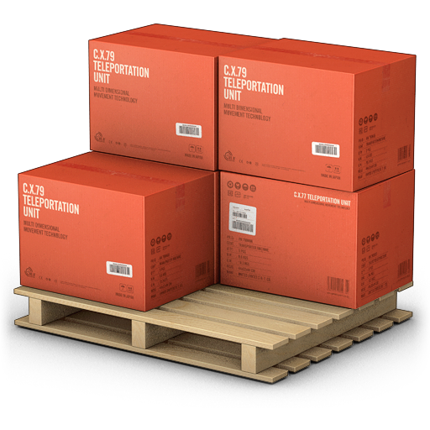


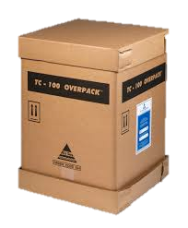


Current organization
CLEAR API’S
SELF SERVICE
DEV
TEAM
RISK
COMPLIANCE
TEAM
AUTOMATION
API
REQUIREMENTS
TEAM
METERING
OPS
TEAM
TEST
TEAM
ETC…
NO FLOW
SILOS
SPECIFIC RESPONSIBILLITY
COST DRIVEN
NO AUTONOMY
PROJECT TEAMS

Slide 16

ORGANIZATIONAL CHANGES TO GET TO DEVOPS
CLEAR API’S
SELF SERVICE
BUSINESS APPLICATION TEAM
CUSTOMER APPLICATION TEAM
IT PLATFORM / TOOLS TEAM
AUTOMATION
BUSINESS APPLICATION TEAM
API
ETC…
CUSTOMER APPLICATION TEAM
Kun je hier de radar per value stream alle kleuren geven in ringen?
Geeft aan dat ieder team nu alles doet wat op voorgaande slide staat, maar nu autonoom
Misschien de radartjes dus nu dan losse Vinyl plaatjes maken en dan de kleuren ringen alle kleuren van voorgaande silos?
METERING
MISSION COMMAND
END TO END
CROSS-FUNCTIONAL
VALUE DRIVEN
AUTONOMOUS
PRODUCT TEAMS
INTELLIGENT INFRASTRUCTURE PLATFORM

Slide 17
2
BOTTLENECK
EXISTING DC AND INERTIA OF IT OPS / MANY RULES ON GOVERNANCE

Slide 18
NEW MODEL CAPEX-/OPEX
ALTERNATIVES TO GET BETTER CUSTOMER EXPERIENCE
FLEXIBLE SCALE
RETOOLING FOR THE CLOUD
FIRST STEP IS TO MOVE OUR EXISTING APPLICATION TO THE CLOUD
FOLLOW DEVOPS PRACTICES
AUTOMATE EVERYTHING!

Slide 19
3
BOTTLENECK
TOOLING / EVERYTHING STILL MANUAL / START AUTOMATING

Slide 20
SETTING UP CI, CD AND
CLOUD DEPLOYMENT(S)
AUTOMATE EVERYTHING
NEED FOR REPEATABLE AND RELIABLE DEPLOYMENTS TO THE CLOUD
USE VSTS & AZURE ARM/CLI
CI, ON EVERY COMMIT TO GIT TRIGGER A BUILD
CD, ON EVERY BUILD, DEPLOY TO CLEAN AZURE RESOURCES

Slide 21
WHERE ARE WE?
WE HAVE VALUE STREAM BASED TEAMS
WE HAVE A FULLY AUTOMATED BUILD
WE HAVE FULLY AUTOMATED DEPLOYMENT TO AZURE APP SERVICES
ISSUE: WE STILL DEPLOY ONCE PER MONTH AFTER WE STABILIZED OUR RELEASE
IMPROVE THE BRANCHING STRATEGY FROM GIT FLOW TO GIT HUB FLOW (TRUNC BASED DEVELOPMENT)
WHAT IS NEXT?

Slide 22
4
BOTTLENECK
BRANCHING STRATEGY SLOWS DOWN RELEASES

Slide 23
CURRENT: GIT FLOW
MASTER
HOTFIX
RELEASE
DEV
FEATURE A
FEATURE B
TIME

Slide 24
NEW: GIT HUB FLOW

Slide 25
BRANCH POLICY
BUILD / REVIEW / MERGE
USE PULL REQUESTS

Slide 26
WHERE ARE WE?
WE CAN RELEASE FASTER
EVERYTHING IS AUTOMATED AND SECURE BY DEFAULT
ISSUE: WE HAVE HAD MANY LIVE SITE INCIDENTS (LSI) CAUSED BY UNFINISHED OR UNTESTED CODE
IMPROVE THE DEVELOPER FLOW AND CREATE MORE STABLE DEPLOYMENTS
INTRODUCE FEATURE TOGGLES
WHAT IS NEXT?

Slide 27
5
BOTTLENECK
DEPLOYMENTS ARE NOT ALWAYS STABLE / ENABLE EXPERIMENTATION

Slide 28
USE OF FEATURE
FLAGS / TOGGLES
WHEN YOU WANT TO SHIP OFTEN, HOW DO YOU COPE WITH UNFINISHED OR UNTESTED CODE?
TRADITIONALLY, YOU USE FEATURE BRANCHES TO ISOLATE
BUT WHAT IF YOU SHIP DAILY OR WEEKLY?
BREAK UP CHANGES IN INDEPENDENT PARTS THAT CAN BE RELEASED SEPARATELY
USE FEATURE TOGGLES/FLAGS TO ENABLE OR DISABLE FEATURES
GIVE BUSINESS CONTROL OVER WHO GETS WHICH FEATURE

Slide 29
DON’T BUILD YOUR OWN,
MANY OPTIONS OUT THERE
IF-ELSE
NFEATURE (LGPL-3.0!, LAST UPDATE JUNE 2012)
FEATURE TOGGLE (APACHE 2.0, LAST UPDATE APRIL 2017)
FEATURE SWITCHER (APACHE 2.0, LAST UPDATE JANUARY 2014)
FLIPIT (APACHE 2.0, LAST UPDATE FEBRUARY 2012)

Slide 30
FEATURE TOGGLES
FEATURE TOGGLES NEED TO BE MAINTAINED!
REMOVE THEM AS SOON AS YOU DO NOT NEED THEM
YOU PRODUCE TECHNICAL DEBT IF YOU KEEP THEM AROUND
source: http://martinfowler.com/articles/feature-toggles.html

Slide 31
LONGEVITY
YEARS
MONTHS
WEEKS
DAYS
PERMISSION TOGGLES
OPS TOGGLES
EXPERIMENT TOGGLES
RELEASE TOGGLES
DYNAMISM
CHANGES WITH A DEPLOYMENT
CHANGES WITH RUNTIME RE-CONFIGURATION
CHANGES WITH EACH REQUEST

Slide 32
WHERE ARE WE?
FASTER AND MORE STABLE DEPLOYMENTS
ISSUE, WE STILL HAVE DOWNTIME AT THE MOMENT OF RELEASE
SOLUTION: BLUE / GREEN DEPLOYMENTS
DEPLOY TO NEW ENVIRONMENT
THE MOMENT DEPLOYMENT IS DONE, SLOWLY MOVE TRAFFIC TO NEW ENVIRONMENT
PREVENTS DOWNTIME
IMPROVED ABILITY TO ROLL BACK
WHAT IS NEXT?

Slide 33
6
BOTTLENECK
DOWNTIME WHEN WE DEPLOY

Slide 34
BLUE / GREEN DEPLOYMENTS
ROUTER
BLUE
BLUE

Slide 35
BLUE / GREEN DEPLOYMENTS
ROUTER
INSTALL NEW VERSION ON ONE OF THE NODES
BLUE
GREEN

Slide 36
BLUE / GREEN DEPLOYMENTS
ROUTER
MOVE TRAFFIC GRADUALLY:
5% -/ 10% -/ 40%
BLUE
GREEN

Slide 37
BLUE / GREEN DEPLOYMENTS
ROUTER
FINALLY 100%
BLUE
GREEN

Slide 38
BLUE / GREEN DEPLOYMENTS
INSTALL GREEN VERSION ALSO ON NODE 2
ROUTER
FINALLY 100%
GREEN
GREEN

Slide 39
BLUE / GREEN DEPLOYMENTS
ROUTER
GREEN
FINALLY TRAFFIC TO BOTH NODES AGAIN
GREEN

Slide 40
WHERE ARE WE?
ALMOST NO DOWNTIME, EXCEPT WHEN WE NEED A DATABASE CHANGE
WHAT IS NEXT?
ZERO DOWNTIME DEPLOYMENT OF THE DATABASE
WHAT IS NEXT?

Slide 41
7
BOTTLENECK
DOWNTIME WHEN WE DEPLOY NEW DATABASE SCHEMA

Slide 42
DB SCHEME CHANGES
AND ZERO DOWNTIME
CREATE BINARIES THAT ARE MULTI SCHEMA COMPATIBLE
DEPLOY BINARIES
NOW CREATE CHANGE IN DB
ENSURE DDL STATEMENTS DON’T BLOCK YOUR QUERIES OR IMPACT DB PERFORMANCE
CREATE SINGLE SCHEMA, LATEST IN CODE
DEPLOY BINARIES
NOW DELETE UNUSED DATA

Slide 43
DB SCHEMA CHANGES-STEP 1
M124 BIN
CREATE BINARIES THAT ARE MULTI SCHEMA COMPATIBLE
M124 DB

Slide 44
DB SCHEMA CHANGES-STEP 2
M125 BIN
UPDATE THE BINARIES TO SUPPORT NEW SCHEMA AND OLD SCHEMA
M124 DB

Slide 45
DB SCHEMA CHANGES-STEP 3
M125 BIN
UPDATE THE DB WITH THE NEW SCHEMA
MIGRATE DATA SLOWLY TO NEW SCHEMA
DON’T UPDATE TABLES, ALWAYS CREATE NEW
WON’T TAKE A LOCK ON THE TABLE
WOULD CREATE A READ BLOCK ON DB
M124 DB
- /
M125 DB

Slide 46
DB SCHEMA CHANGES-STEP 4
M126 BIN
UPDATE BINARIES TO ONLY USE NEW SCHEMA
M125 DB

Slide 47
DB SCHEMA CHANGES-STEP 5
M126 BIN
CLEAN THE OLD SCHEMA
M126 DB

Slide 48

WHERE ARE WE?
ALL AUTOMATED
MULTIPLE RELEASES A DAY
ZERO DOWNTIME DEPLOYMENTS INCUDE DB CHANGES
WHAT IS NEXT?
BUSINESS NEEDS MORE INSIGHTS INTO FEATURES BEING USED
ADD TELEMETRY TO THE SYSTEM
WHAT IS NEXT

Slide 49
8
BOTTLENECK
NO INSIGHTS IN USAGE AND AVAILABILLITY

Slide 50
TELEMETRY
USAGE
PERFORMANCE
AVAILABILITY
LOGS

Slide 51
WHERE ARE WE?
ALL AUTOMATED
WE KNOW WHICH FEATURES ARE BEING USED
MULTIPLE RELEASES A DAY
WHAT IS NEXT?
STILL NEED MANUAL APPROVALS
FIX THIS BY ADDING RELEASE GATES THAT USE TELEMETRY
WHAT IS NEXT

Slide 52
9
BOTTLENECK
STILL MANUAL APPROVALS

Slide 53
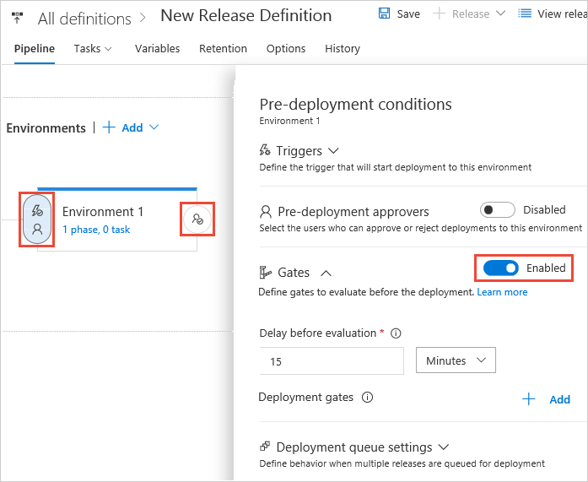
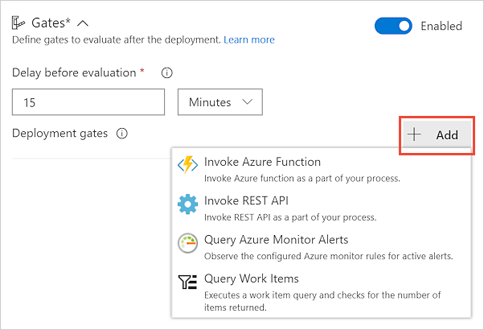
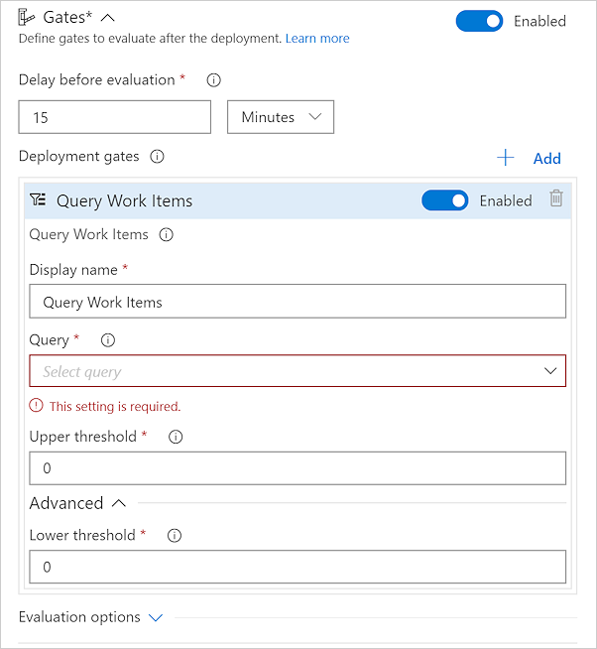
RELEASE GATES

Slide 54
RELEASE GATES
EVALUATION
GATES SUCCESS, DEPLOYMENT APPROVED
APPROVE
FAIL
FAIL
PASS
FAIL
FAIL
PASS
GATE 1
GATE 2
PASS
FAIL
PASS
PASS
PASS
PASS
GATE 3
FAIL
FAIL
PASS
PASS
PASS
PASS
SAMPLING INTERVALS
STABILIZATION TIME
TIMEOUT

Slide 55
RELEASE GATES
EVALUATION
GATES SUCCESS, DEPLOYMENT REJECTED
REJECT
FAIL
FAIL
PASS
FAIL
FAIL
PASS
PASS
PASS
PASS
PASS
GATE 1
GATE 2
PASS
FAIL
PASS
PASS
PASS
FAIL
FAIL
FAIL
FAIL
FAIL
GATE 3
FAIL
FAIL
PASS
PASS
PASS
PASS
PASS
PASS
PASS
PASS
SAMPLING INTERVALS
STABILIZATION TIME
TIMEOUT

Slide 56
GDBC INC. FINAL RESULTS
MOVED FROM ONCE A MONTH TO MULTIPLE TIMES A DAY
ORGANIZATION TRAINED TO RUN THE BUSINESS
EVERYONE ENGAGED IN THE TEAM
EVERYONE EMPOWERED
EVERYONE RESPONSIBLE AND ON CALL

Slide 57
GLOBAL DEVOPS BOOTCAMP CHALLENGES
EXPLANATION
WILL BE ADDED IN THE WEEK OF JUNE 9

Slide 59
slide closing animation / handover to challenges

